Slide 1
bossting house prize dashboard (LINEAR REGRESSION)
File created on: 7/22/2025 10:18:42 AM

Slide 2
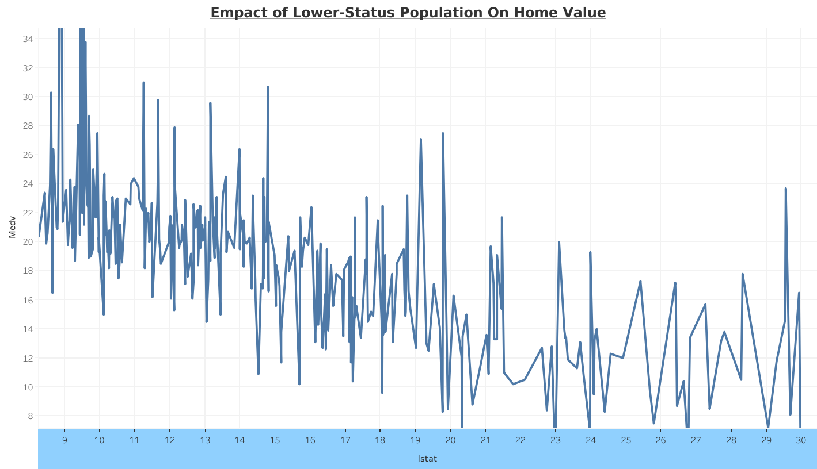

Slide 3
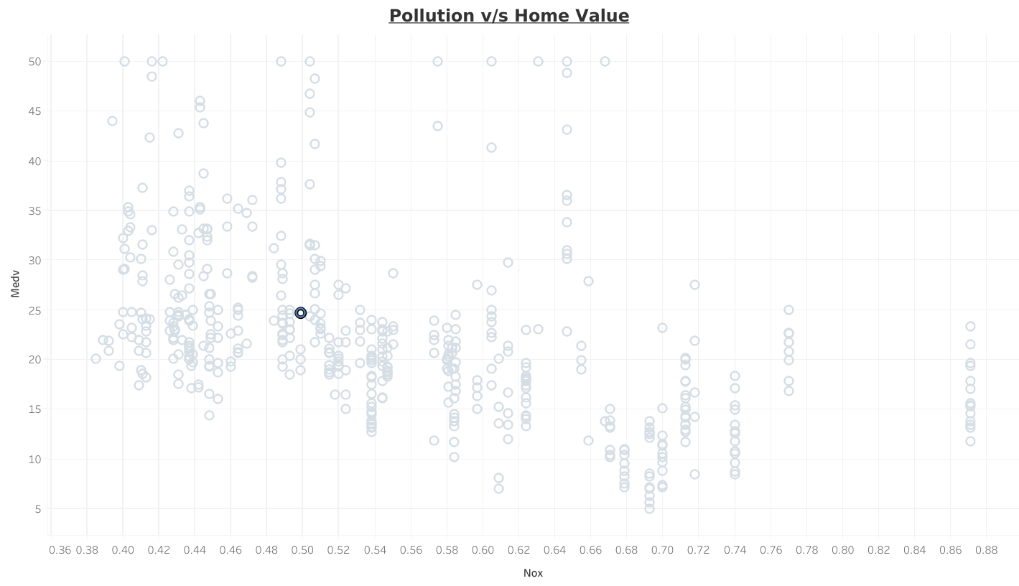

Slide 4
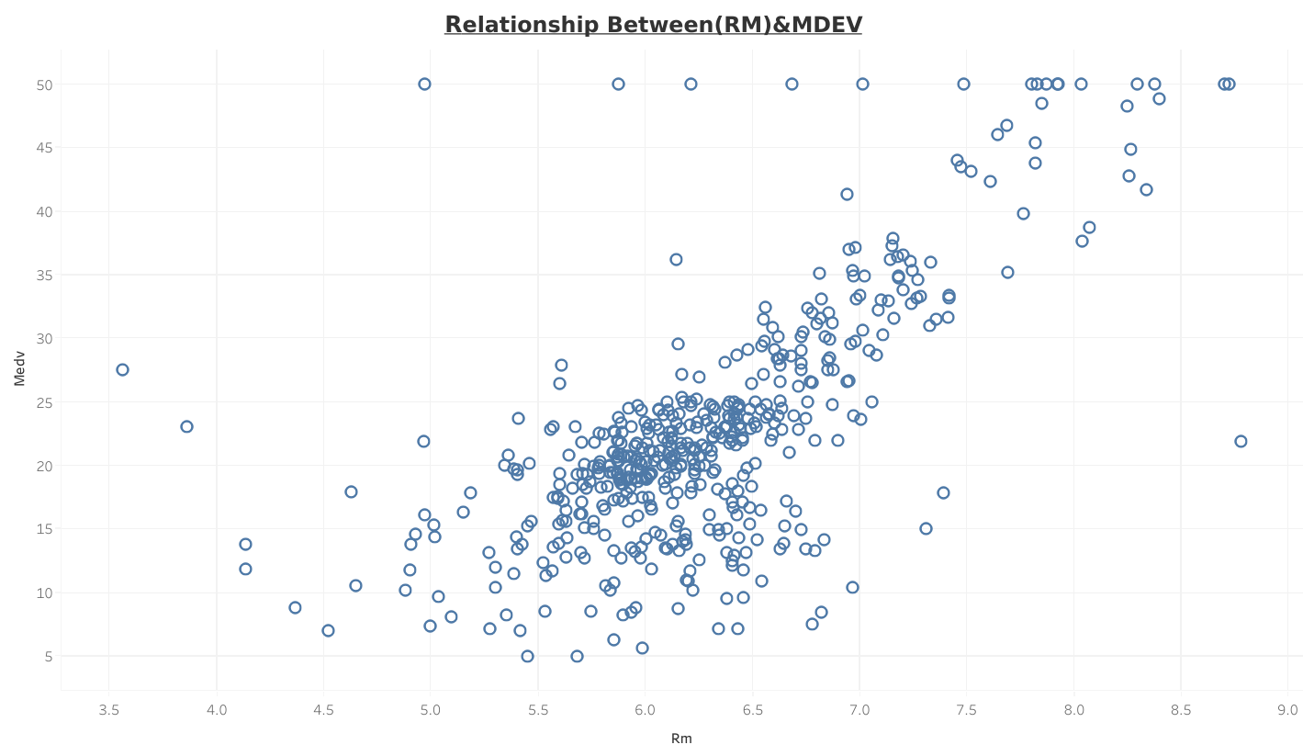

Slide 5
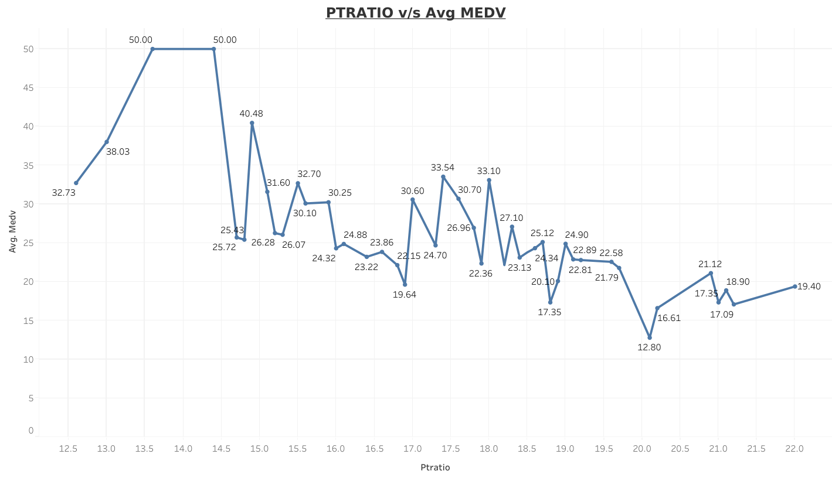

Slide 6
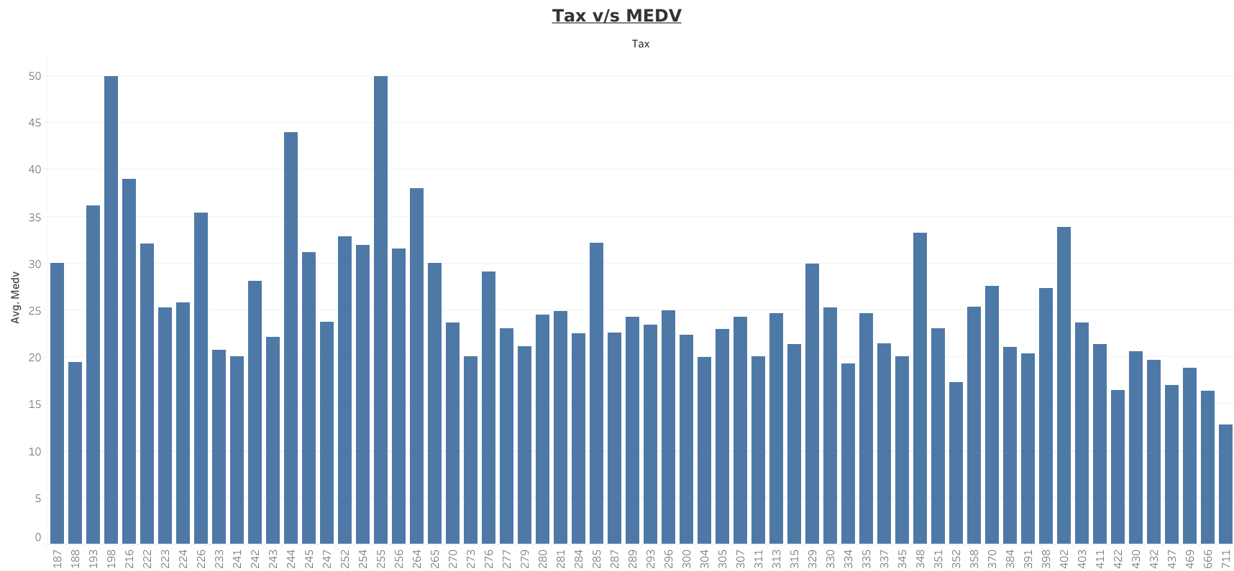

Slide 7
